Slide 1
Investigating Incident Response Readiness for Data Breaches in Cloud Storage
Assessing Detection, Response, Recovery and Prevention Capabilities
2026
Presented by
Aaditya Vishwakarma
Aaditya Vishwakarma
October
2026

Slide 2
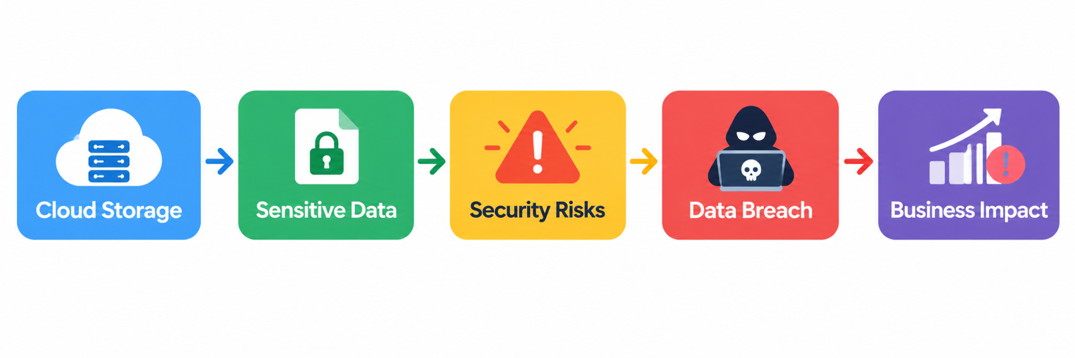
Introduction
Cloud storage has become an essential part of modern organizations, allowing businesses to store and access large amounts of data remotely.
1
2
However, sensitive cloud data can be exposed through stolen credentials, misconfigured storage, weak access controls, phishing, insider threats, and vulnerable applications.
3
When a data breach occurs, preventing further damage depends not only on security controls but also on the organization's incident response readiness.
4
This study investigates how prepared organizations are to detect, investigate, contain, and recover from data breaches in cloud storage.
Aaditya Vishwakarma
October
2026

Slide 3
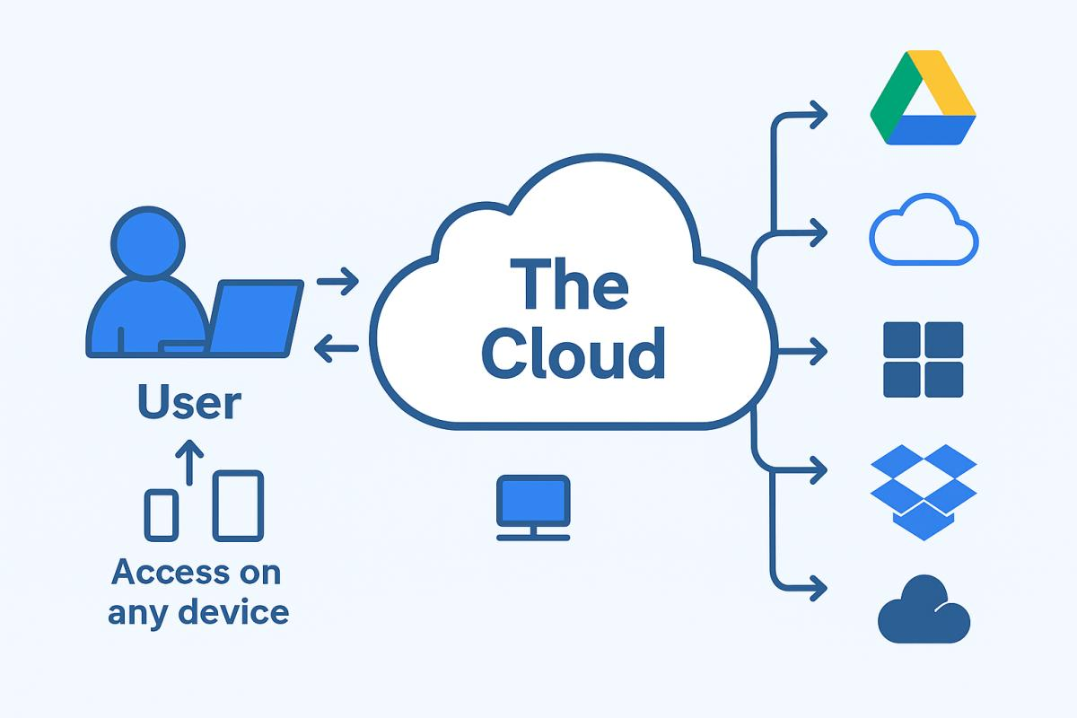
Cloud Storage
What is Cloud Storage?
Cloud storage is a service that allows individuals and organizations to store, manage, and access data on remote servers through the Internet instead of relying only on local computers or physical storage devices.
Why Organizations Use Cloud Storage
Scalability — Storage can be increased when required.
Accessibility — Data can be accessed from different locations and devices.
Availability — Data can remain available even when local systems fail.
Cost Efficiency — Reduces the need for maintaining physical storage infrastructure.
Backup & Recovery — Helps organizations maintain copies of important data.
Examples
Amazon S3 | Microsoft Azure Blob Storage | Google Cloud Storage | OneDrive | Google Drive
Security Concern
The same accessibility that makes cloud storage useful can also create security risks when access controls, permissions, credentials, or configurations are improperly managed.
Aaditya Vishwakarma
October
2026

Slide 4
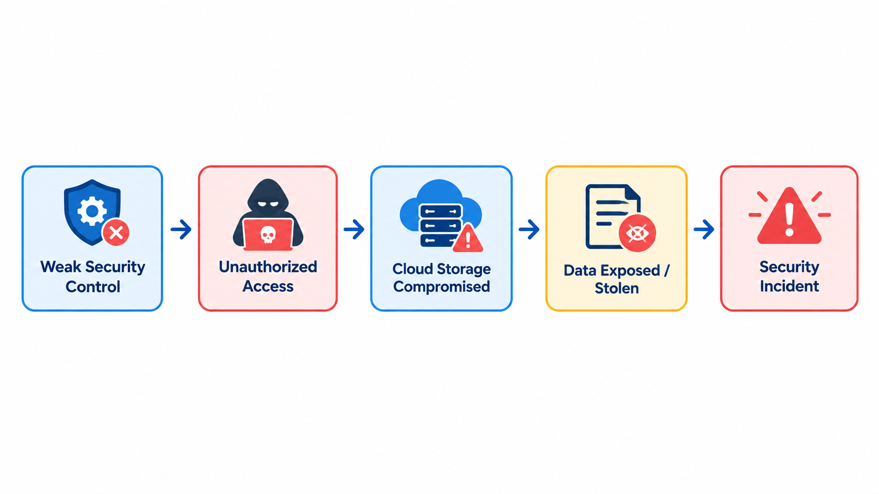
Cloud Data Breach
What is a Cloud Data Breach?
A cloud data breach occurs when an unauthorized person gains access to, exposes, modifies, or steals data stored in a cloud environment.
Common Causes
🔑 Stolen Credentials — Attackers obtain usernames, passwords, or access tokens.
⚙️ Misconfiguration — Cloud storage is accidentally given excessive or public access.
👤 Excessive Permissions — Users receive more access than they actually need.
🎣 Phishing — Employees are tricked into revealing credentials.
🔌 Insecure APIs — Vulnerable interfaces can provide unauthorized access.
🧑‍💻 Insider Threats — Authorized users misuse their access.
🦠 Malware/Ransomware — Malicious software can compromise cloud-connected resources.
Affected Data
👤 Personal Information
💳 Financial Records
📄 Business Documents
🔐 Credentials & Access Tokens
💾 Backups & Databases
🧑‍💼 Customer & Employee Records
Aaditya Vishwakarma
October
2026

Slide 5

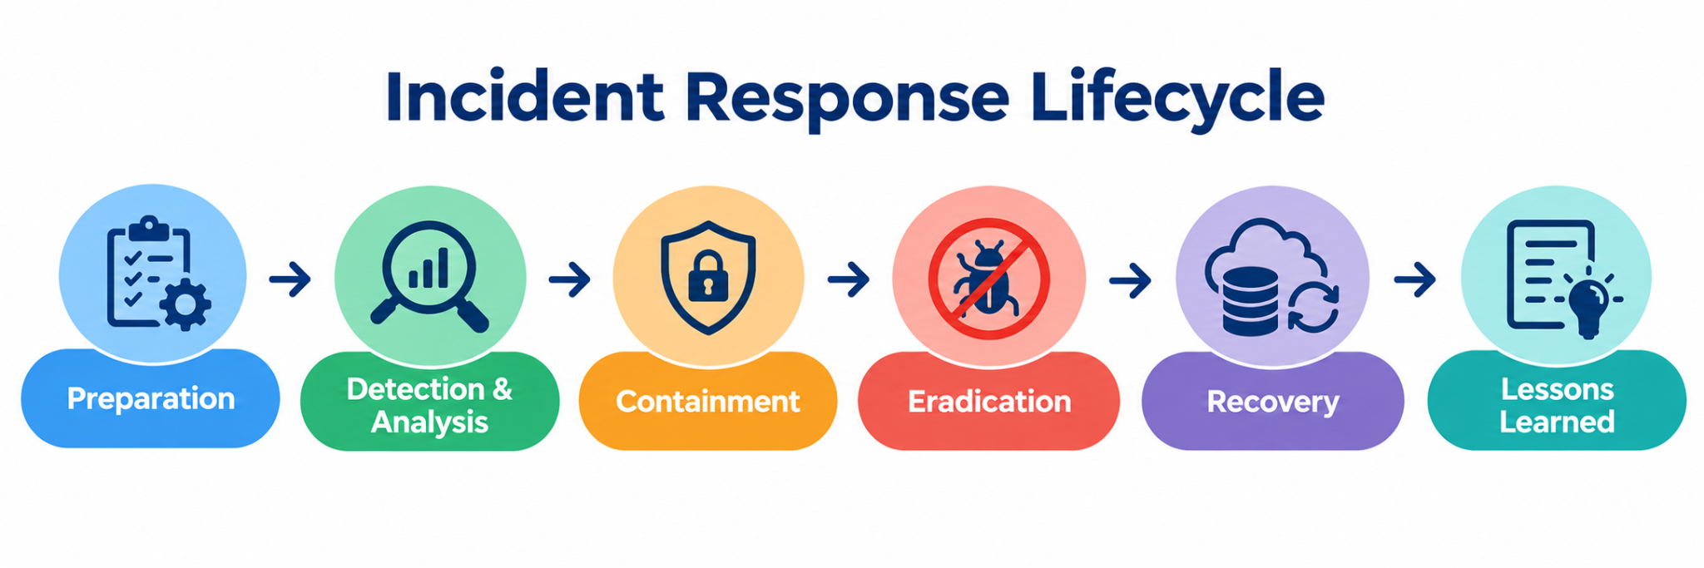
Why It Matters in Cloud Storage
A well-planned incident response process helps organizations reduce data loss, downtime, unauthorized access, and further compromise after a cloud breach.
Incident Response
Incident Response (IR) is the structured process an organization follows to detect, investigate, contain, eliminate, and recover from a cybersecurity incident.
Main Objectives
🚨 Detect the security incident quickly
🔍 Investigate what happened
🛑 Contain the threat and limit damage
🧹 Remove the cause of the incident
🔄 Recover affected systems and data
📋 Learn from the incident and improve security
Aaditya Vishwakarma
October
2026

Slide 6
Incident Response Readiness
Incident Response Readiness refers to an organization's ability to quickly detect, investigate, contain, recover from, and learn from a security incident.
Key Readiness Factors
🔍 Detection Capability — Ability to identify suspicious activity quickly
📊 Monitoring & Logging — Availability of cloud logs and security events
👥 Trained Response Team — People with defined roles and responsibilities
📋 Incident Response Plan — Documented procedures for handling incidents
🔐 Access & Security Controls — Strong authentication, permissions, and access management
💾 Backup & Recovery — Ability to restore affected data and services
🧪 Regular Testing — Drills, simulations, and review of response procedures
Readiness Goal
Detect → Respond → Recover → Improve
A prepared organization can reduce the impact and duration of a cloud data breach.
Aaditya Vishwakarma
October
2026

Slide 7
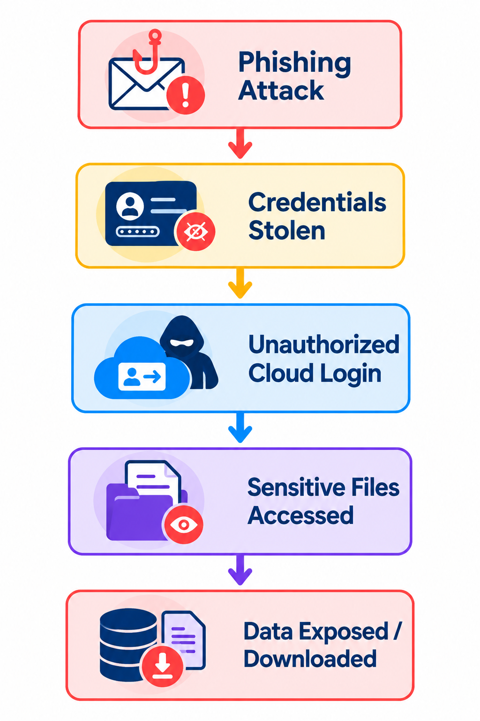
Cloud Data Breach Scenario
Scenario
An employee's cloud account credentials are stolen through a phishing attack.
The attacker uses the stolen credentials to access the organization's cloud storage and obtains unauthorized access to sensitive files.
Potentially Affected Data
Customer Records
Employee Information
Financial Documents
Business Files
Backups
Access Credentials
Aaditya Vishwakarma
October
2026

Slide 8
When a cloud data breach is identified, the organization should follow a structured response process to limit damage and restore secure operations.
1. Detect & Analyze 🔍
Identify suspicious activity and determine the scope of the breach.
2. Contain 🛑
Disable compromised accounts, revoke sessions/tokens, and restrict affected resources.
3. Eradicate 🧹
Remove malicious access, fix vulnerabilities, and strengthen security controls.
4. Recover 🔄
Restore affected systems/data from trusted backups and resume normal operations.
5. Learn & Improve 📋
Document the incident, identify gaps, and improve the incident response plan.
How Should the Organization Respond?
Aaditya Vishwakarma
October
2026

Slide 9
Cloud Evidence & Forensic Investigation
What is Investigated?
During a cloud data breach, investigators collect and analyze digital evidence to understand how the attacker entered, what they accessed, and what actions were performed.
Key Sources of Evidence
📋 Cloud Audit Logs — User activities, API calls, and administrative actions
🔐 Authentication Logs — Login attempts, failed logins, and account activity
🌐 Network Logs — IP addresses, connections, and unusual traffic
📁 File & Storage Logs — File access, modification, deletion, and downloads
👤 User & IAM Records — Accounts, permissions, roles, and access changes
🚨 Security Alerts — Suspicious activities detected by security tools
Investigation Flow
Collect Evidence → Analyze Logs → Identify Attack Path → Determine Impact → Document Findings
Aaditya Vishwakarma
October
2026

Slide 10
Incident Response Readiness Assessment
An organization's readiness depends on its ability to detect, investigate, contain, recover from, and prevent cloud security incidents.
KEY ASSESSMENT AREAS
🔍 Detection Can suspicious activity be identified quickly?
📋 Incident Response Plan Are documented procedures available for handling incidents?
👥 Response Team Are roles and responsibilities clearly defined?
📊 Logging & Monitoring Are sufficient cloud logs available for detection and investigation?
🛑 Containment Can compromised accounts and cloud resources be isolated quickly?
💾 Recovery Can affected data and services be restored safely?
🧪 Testing & Improvement Are response procedures regularly tested and updated?
READINESS FLOW
Detection → Investigation → Containment → Recovery → Prevention
Aaditya Vishwakarma
October
2026

Slide 11
Proposed Cloud Breach Incident Response Framework
An organization's readiness depends on its ability to detect, investigate, contain, recover from, and prevent cloud security incidents.
KEY ASSESSMENT AREAS
🔍 Detection Can suspicious activity be identified quickly?
📋 Incident Response Plan Are documented procedures available for handling incidents?
👥 Response Team Are roles and responsibilities clearly defined?
📊 Logging & Monitoring Are sufficient cloud logs available for detection and investigation?
🛑 Containment Can compromised accounts and cloud resources be isolated quickly?
💾 Recovery Can affected data and services be restored safely?
🧪 Testing & Improvement Are response procedures regularly tested and updated?
READINESS FLOW
Detection → Investigation → Containment → Recovery → Prevention
Aaditya Vishwakarma
October
2026

Slide 12

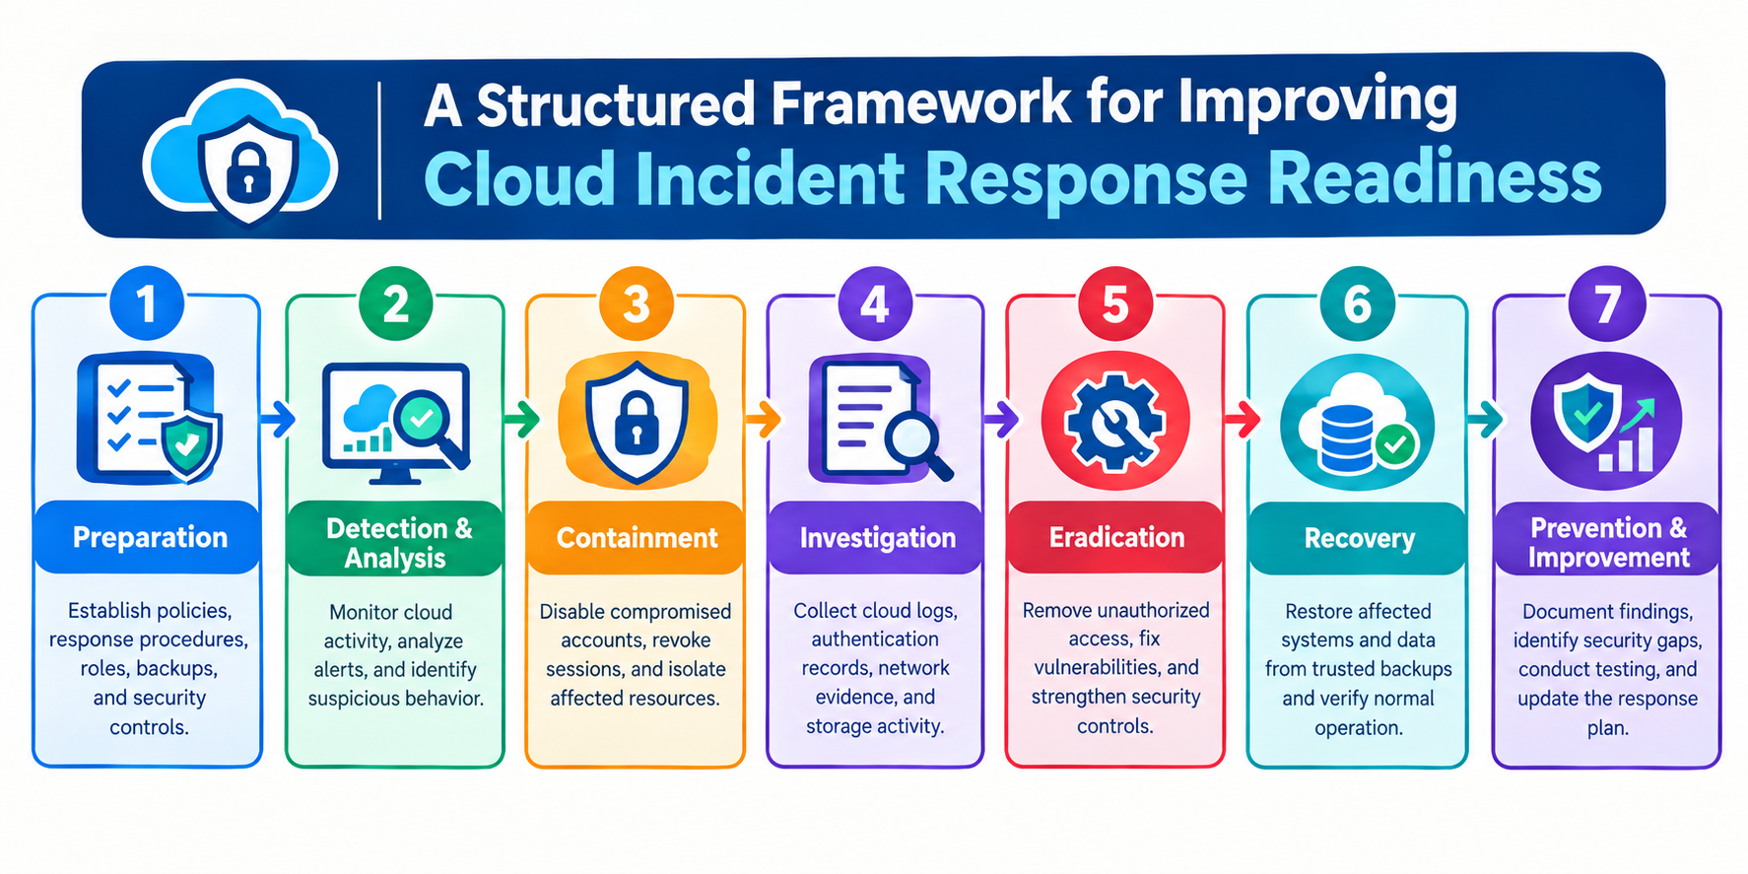
Proposed Cloud Breach Incident Response Framework
Aaditya Vishwakarma
October
2026

Slide 13
Technologies to Improve Incident Response Readiness
Key Technologies
☁️ Cloud Security Services
Monitor cloud resources, configurations, identities, and security events.
📊 SIEM
Collects and correlates logs from cloud services, systems, and applications to identify suspicious activity.
🚨 EDR / XDR
Detects and investigates suspicious activity across endpoints, networks, and cloud environments.
🔐 IAM & MFA
Controls user access and strengthens authentication for cloud resources.
📝 Cloud Audit Logging
Records user actions, API calls, authentication events, and resource activity.
🤖 SOAR & Automation
Automates repetitive response actions such as alert handling, account isolation, and notification.
💾 Backup & Recovery
Provides trusted copies of data and supports restoration after an incident.
Aaditya Vishwakarma
October
2026

Slide 14
Major Challenges in Cloud Incident Response
Introduction
Even when an organization has security tools and an incident response plan, several challenges can delay detection, investigation, containment, and recovery of cloud data breaches.
Major Challenges
1. Limited Visibility
Security teams may not have complete visibility across all cloud services, accounts, and resources.
2. Incomplete Logging
Missing, disabled, or short-retention logs can make it difficult to reconstruct an attack.
3. IAM & Permission Issues
Excessive permissions, weak authentication, and misconfigured access controls can increase the impact of a breach.
4. Multi-Cloud Complexity
Managing security across multiple cloud providers and hybrid environments makes monitoring and response more difficult.
5. Alert Overload
Large numbers of security alerts can make it difficult for analysts to identify critical incidents quickly.
7. Evidence Collection Challenges
Collecting and preserving reliable cloud evidence can be difficult because infrastructure and data are distributed across services.
Bottom Flow
Limited Visibility → Delayed Detection → Difficult Investigation → Slow Response → Greater Impact
Aaditya Vishwakarma
October
2026

Slide 15
Recommendations
Introduction
Organizations can improve their cloud incident response readiness by strengthening preventive controls, monitoring capabilities, response procedures, and recovery processes.
Key Recommendations
1. Strengthen IAM & MFA
Use least-privilege access, strong authentication, and multi-factor authentication.
2. Enable Comprehensive Logging
Collect and retain authentication, audit, network, and storage activity logs.
3. Implement Continuous Monitoring
Monitor cloud environments continuously to identify suspicious activity early.
4. Develop a Cloud Incident Response Plan
Define clear procedures, responsibilities, escalation paths, and communication processes.
5. Automate Response Actions
Use SIEM, SOAR, and XDR capabilities to accelerate alert investigation and containment.
Aaditya Vishwakarma
October
2026

Slide 16
Conclusion
  Cloud Security Is Essential: Cloud storage protects valuable data, but misconfigurations and unauthorized access can lead to data breaches.
  Readiness Improves Detection: Effective monitoring and logging help organizations identify suspicious activities quickly.
  Structured Response Reduces Damage: A clear incident response plan supports investigation, containment, and recovery.
  Security Technologies Strengthen Protection: IAM, MFA, SIEM/XDR, and secure backups improve incident response capabilities.
  Continuous Improvement Is Necessary: Regular testing, staff training, and lessons learned help organizations become better prepared for future incidents.
Aaditya Vishwakarma
October
2026

Slide 17
Thank you
Contact
Aadityav1@duck.com
Aaditya Vishwakarma
October
2026

